Slide 1

Heartbeat Classification
By
←→
Qi Bao
Saikot Das Joy

Slide 2
Project Overview
Goal: Automatically classify heart rhythms from ECG signals
Dataset:
The MIT-BIH Arrhythmia Dataset
The PTB Diagnostic ECG Dataset
Data sets have been preprocessed by the provider and has undergone normalization. Each ECG signal is fully annotated
Tasks
Compare the performance of various models on the given dataset, with a particular focus on the comparison between ensemble tree models and neural network models.
Attempt transfer learning by applying a model trained on a large dataset to a smaller dataset and demonstrate the results.

Slide 3
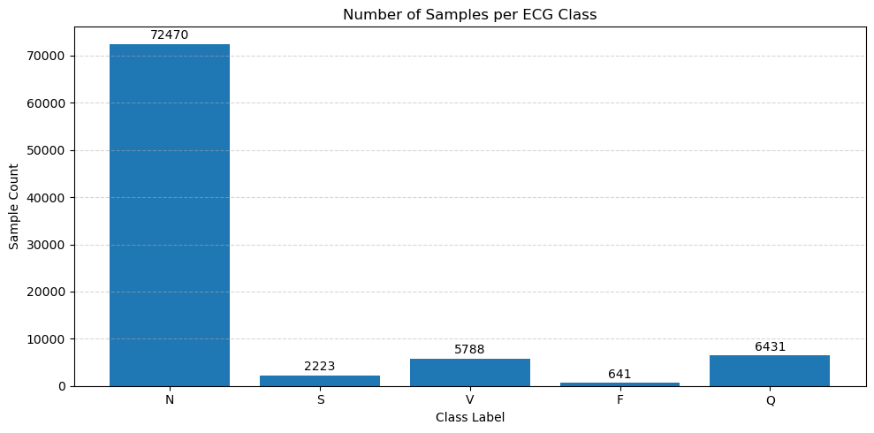

MIT BIH Data Preprocessing
Category | Code | Meaning | Indication
N | 0 | Normal beat | Healthy
S | 1 | Supraventricular ectopic beat | Pathological
V | 2 | Ventricular ectopic beat | Pathological
F | 3 | Fusion beat | Pathological
Q | 4 | Unknown beat | Potentially pathological
Number of Samples: 109446
Number of Categories: 5
Sampling Frequency: 125Hz
Classes: ['N': 0, 'S': 1, 'V': 2, 'F': 3, 'Q': 4]

Slide 4
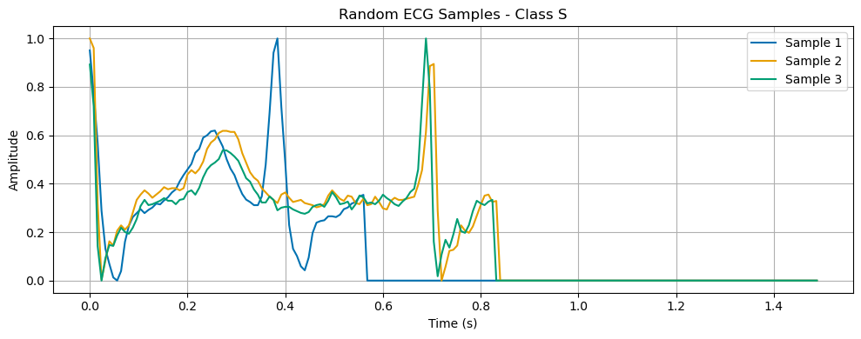
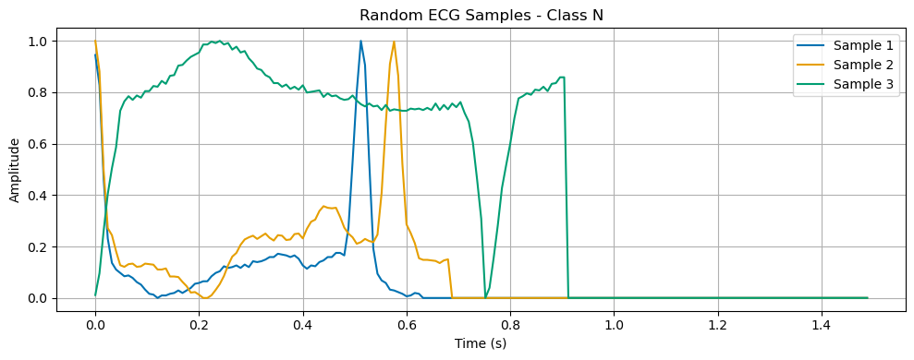
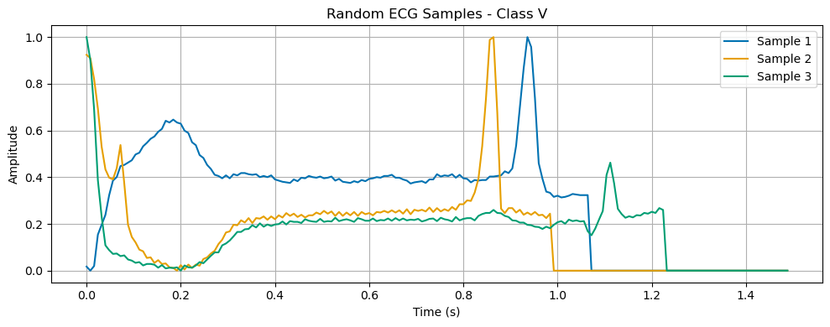
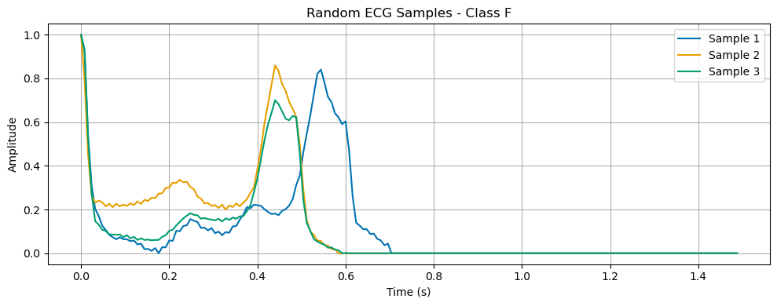
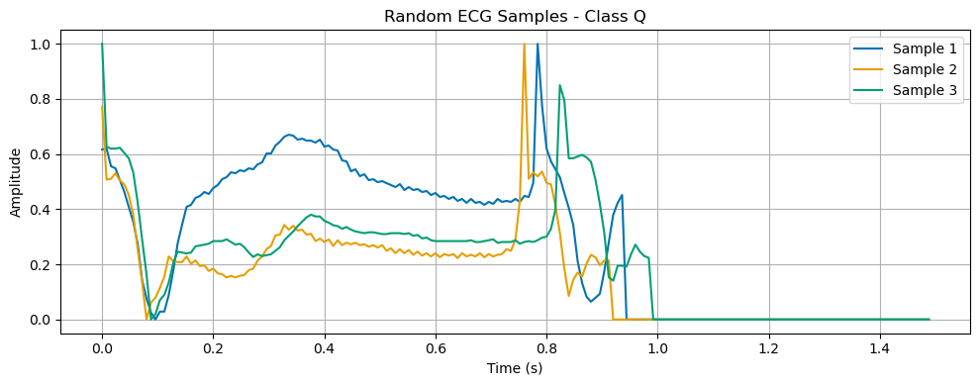

MIT BIH Data Intuition

Slide 5
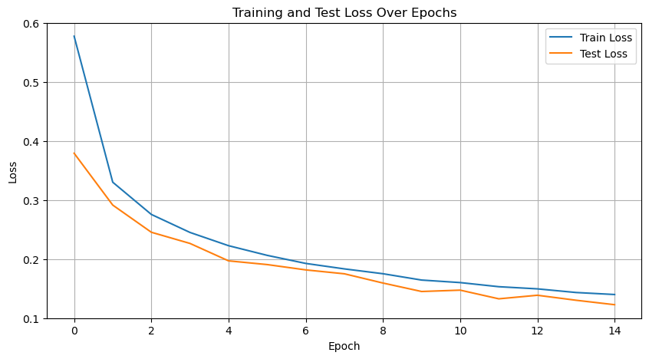
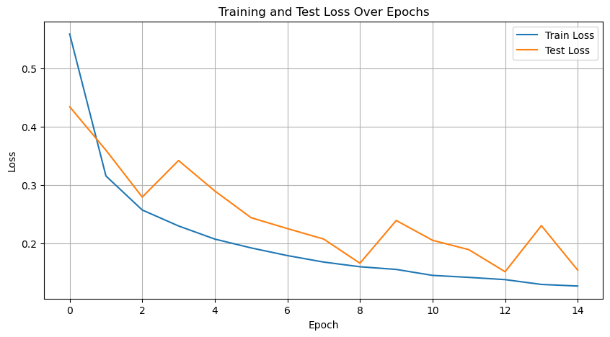
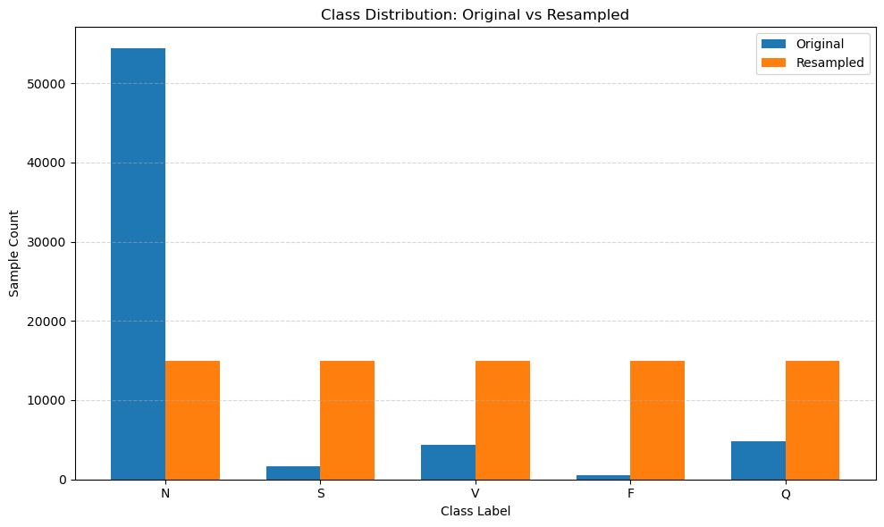
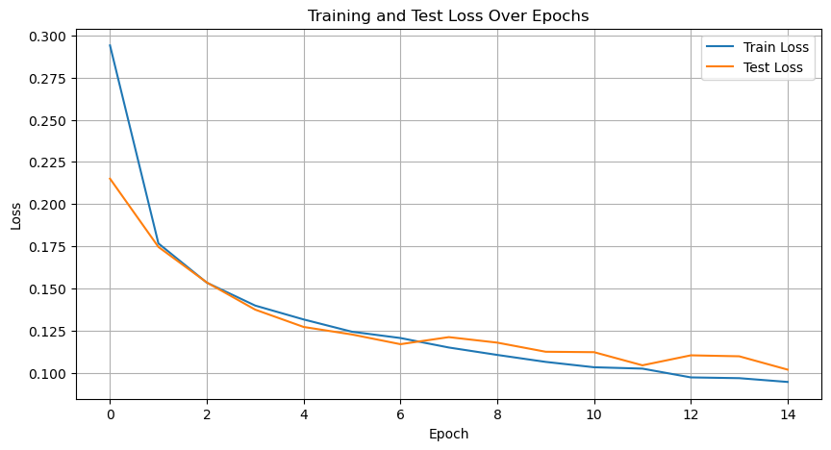
MIT BIH Resampling
Raw-Data
SMOTE-Tomek
Target: around 20000 entries for each class, under-sampling for N, over-sampling for other classes.
Under-sampling:
RandomUnderSampler
Over-sampling:
SMOTE-Tomek to 20000 each class
GAN to 15000 each class due to separate val set
Train-Val-Split
Raw-Data
Train-Val-Split
SMOTE-Tomek
Raw-Data
Train-Val-Split
GAN

Slide 6
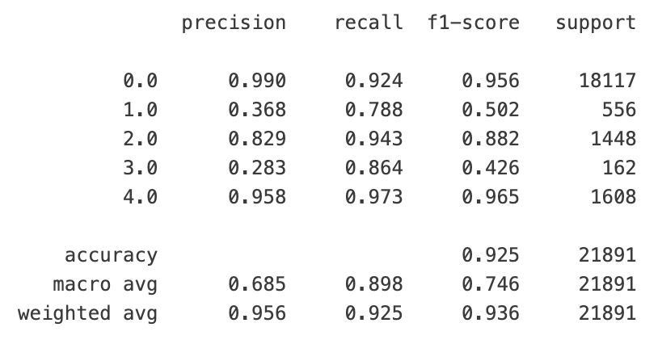
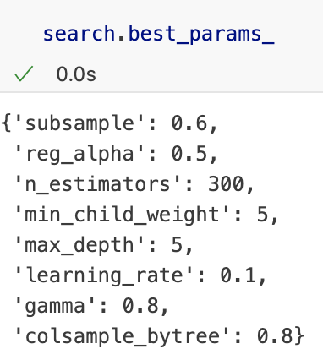
MIT BIH Modeling
Missing a diagnosis (false negative) can be fatal
False positives can be addressed with follow-up tests
Imbalanced datasets are common
Need benchmarks that aren't skewed by the dominant class
Macro average recall is chosen as the performance benchmark
Gives equal weight to each class, suitable for imbalanced data
Using XGBoost with RandomizedSearchCV (30 iterations)
Achieved macro average recall: 0.898

Slide 7
MIT BIH Deep Learning Models
CNN v1 CNN v2
FC
Dropout
Global AvePool
Max Pool
Batch Norm
3 Conv
Max Pool
Batch Norm
5 Conv
Max Pool
Batch Norm
7 Conv

Slide 8
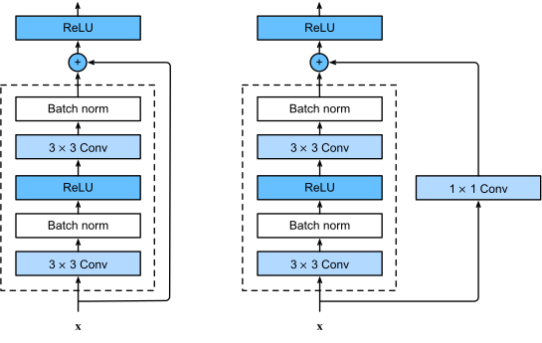
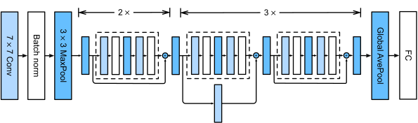
MIT BIH Deep Learning Models
Converted standard Residual Network 18 into 1 dimensional.
Added a dropout (0.5) layer between “Global AvePool” and “FC” to prevent overfitting

Slide 9
MIT BIH Deep Learning Models Comparison
Performance on Validation Dataset
Performance on Test Dataset
Model | Macro avg recall | Accuracy
CNN v1 | 0.828 | 0.976
CNN v2 | 0.866 | 0.981
ResNet | 0.934 | 0.985
Model | Macro avg recall | Accuracy
ResNet | 0.919 | 0.982
XGBoost | 0.898 | 0.925

Slide 10
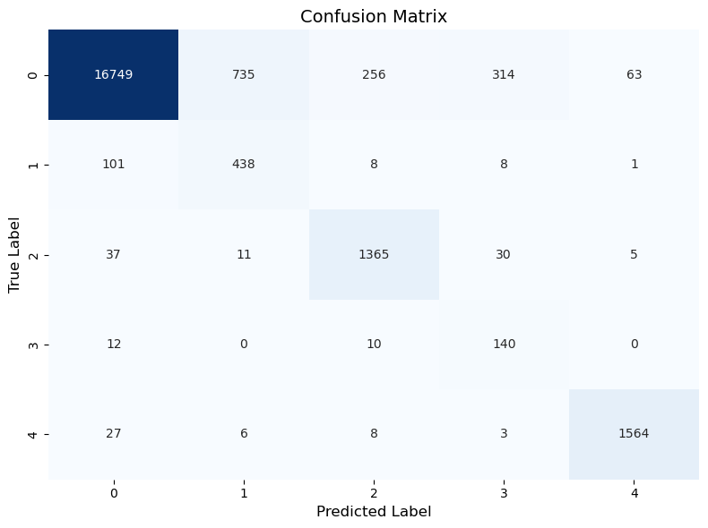
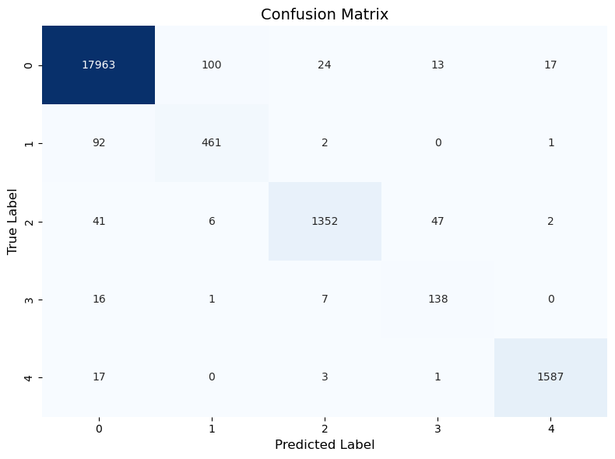
MIT BIH Confusion Matrix

Slide 11
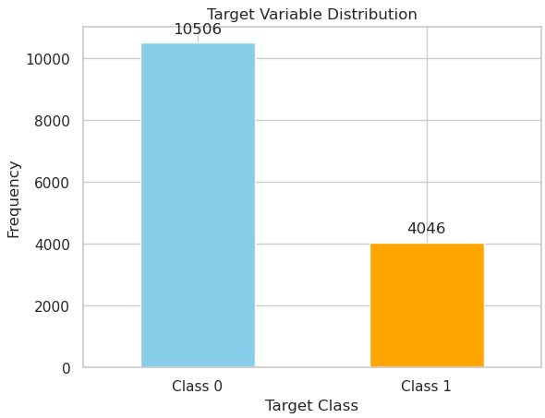
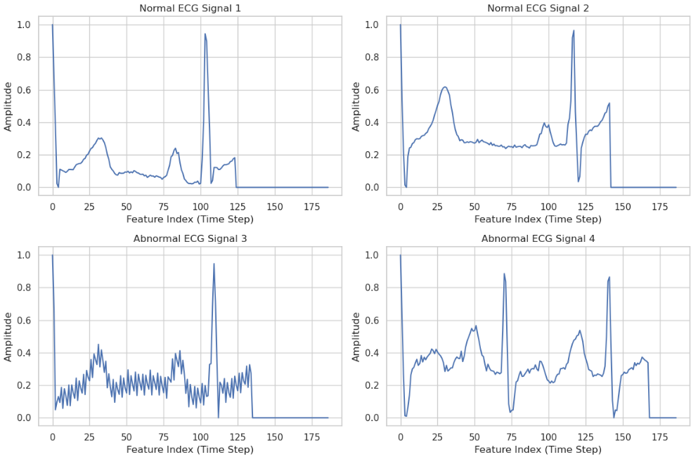
PTB Dataset Overview
ptbdb_abnormal.csv: Abnormal ECG samples.
ptbdb_normal.csv: Normal ECG samples.

Slide 12
Preprocessing & Model Tuning
⚙️🧮 Feature Scaling
Applied StandardScaler to normalize input features
🧵 Model Structure
All models were implemented using Pipeline to streamline preprocessing and training steps
🔍 Hyperparameter Tuning
GridSearchCV was used to perform exhaustive search over specified parameter grids
Ensured optimal model configuration through cross-validation
Model | Best Parameters | Best Score
Random Forest | max_depth: 15, min_samples_split: 2, n_estimators: 200 | 0.9659
SVM | C: 10, gamma: 'scale', kernel: 'rbf' | 0.9531
Logistic Regression | C: 1, solver: 'liblinear' | 0.8236
XGBoost | learning_rate: 0.2, max_depth: 7, n_estimators: 200 | 0.9781
K-Nearest Neighbors | n_neighbors: 3, weights: 'distance' | 0.9274
Gradient Boosting | learning_rate: 0.2, max_depth: 7, n_estimators: 200 | 0.9795
AdaBoost | learning_rate: 1, n_estimators: 200 | 0.8962
Decision Tree | max_depth: 15, min_samples_split: 2 | 0.9176
CatBoost | depth: 7, iterations: 200, learning_rate: 0.1 | 0.9777

Slide 13
Deep Learning Model Adaptation Summary
✅ Models Used
CNN v1
CNN v2
ResNet1D
📚 Original Dataset
MIT-BIH Arrhythmia Dataset
🧪 Adapted To
PTB Diagnostic ECG Dataset Model
🔧 Key Modification
Output layer adjusted to 2 classes (for binary classification task in PTB dataset)
🚀 Performance
All adapted models showed strong performance on the PTB dataset

Slide 14
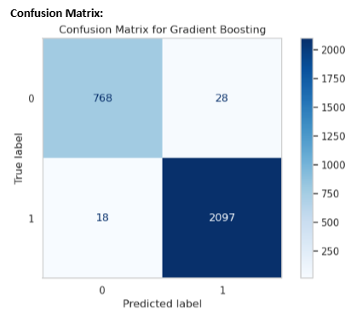
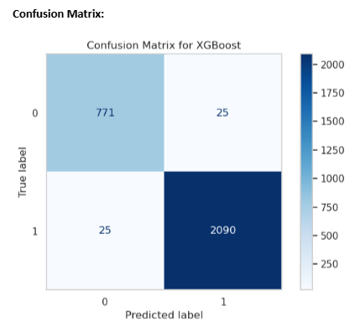
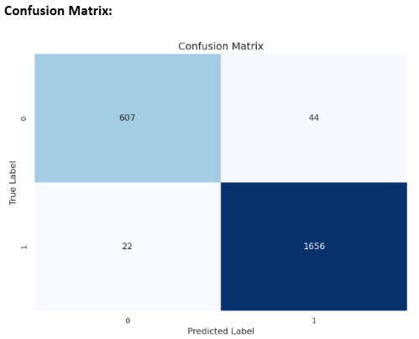
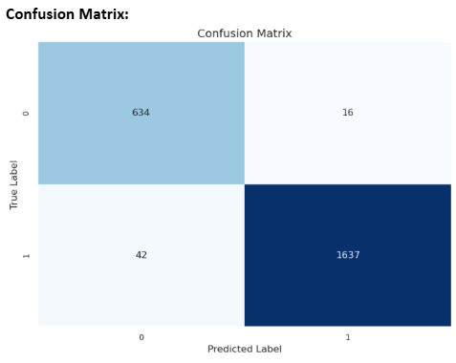
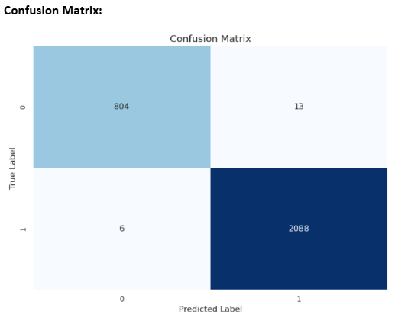
Model Outcome Comparison
Gradient Boosting
XGBoost
CNN v1
CNN v2
ResNet1D
Model | Macro Avg Recall
XGBoost | 0.980
Gradient Boosting | 0.980
CNN v1 | 0.960
CNN v2 | 0.975
ResNet1D | 0.991

Slide 15
Conclusion and future work
Attention + LSTM enhance temporal feature learning and model performance
SMOTE-Tomek pairs well with ensemble tree models
GAN augmentation performs better with neural networks
Ensemble trees train faster, but performance plateaued at ~90% macro recall
GridSearchCV is less efficient on GPU vs. PyTorch-based training
ResNet significantly outperforms standard CNNs in recall and accuracy

Slide 16


